Slide 1

Last-Mile Delivery Operations Analytics

Slide 2
Meet the Team
TEAM LEADER
NETTEM RUSHIKA
Background : B.Tech in Computer Science and Engineering
Why I want to learn Data Science?: I want to learn Data Science to improve my problem-solving skills, understand how data transforms into insights, and make better decisions for real-world challenges.
Experience : Fresher
LinkedIn: https://www.linkedin.com/in/rushika-nettem-b755062b0/
GitHub :
TEAM MEMBER
SIVANI CHALLA
Background : B.Tech in Computer Science and Engineering
Why I want to learn Data Science? : I want to learn Data Science to build strong analytical skills, work with real-world data, and solve business problems using data-driven Insights and machine learning.
Experience : Fresher
LinkedIn : https://www.linkedin.com/in/challa-sivani-487803372
GitHub :https://github.com/sivanichalla12/Last-Mile-Delivery-Operations-Analytics.git

Slide 3
Table of contents
Project Overview
Business Scenario
Business Objectives
Dataset & Database Overview
ER Diagram & Database Structure
Analysis of the Objectives
Overall Key Findings
Business Recommendations
Conclusion
Q&A

Slide 4
Project Overview
This project analyzes last-mile delivery operations using MySQL to transform operational data into actionable insights.
It covers customers, orders, deliveries, drivers, and vehicles.
The analysis focuses on delivery demand, customer behaviour, delivery performance, and resource utilization.
SQL-based analysis is used to identify delivery patterns, performance gaps, and operational problems.
The insights support data-driven decisions to improve delivery efficiency and service quality.

Slide 5
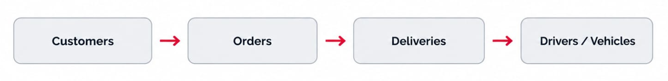
Business Scenario
QuickRoute Logistics manages last-mile deliveries across multiple delivery zones.
As order volumes increase, the Operations team needs better visibility into delivery demand and operational performance.
The company needs to understand customer ordering behaviour and demand across zones and service types.
The team also needs to evaluate delivery performance, driver and vehicle utilization, and delivery problems.
SQL analysis helps convert operational data into insights for better delivery efficiency and service quality.

Slide 6
Business Objective
Analyze Delivery Demand
Understand Customer Ordering Behaviour
Evaluate Delivery Performance
Measure Driver and Vehicle Performance
Identify Delivery Problems
Generate Data-Driven Insights
- across zones, service types, priority levels, and time periods.
1
2
- analyzing order frequency, order value, customer types, and zones.
3
- using delivery status, duration, zones, and service types.
4
- by analyzing workload, delivery outcomes, duration, and vehicle usage.
5
- such as multiple attempts, failed deliveries, and problem-prone zones.
6
- to support better operational decisions and improve delivery efficiency.

Slide 7
Dataset & Database Overview
Table | Description | Rows
Customers | Customer information and category | 400
Orders | Order details, value, service and priority | 3000
Deliveries | Delivery status, duration and attempts | 3500
Drivers | Driver information and availability | 80
Vehicles | Vehicle details and capacity | 50
Observation The dataset contains 3,500 delivery records for 3,000 orders, indicating that some orders may have multiple delivery records.
Finding The five tables are connected through IDs, enabling analysis across customers, orders, deliveries, drivers, and vehicles.

Slide 8
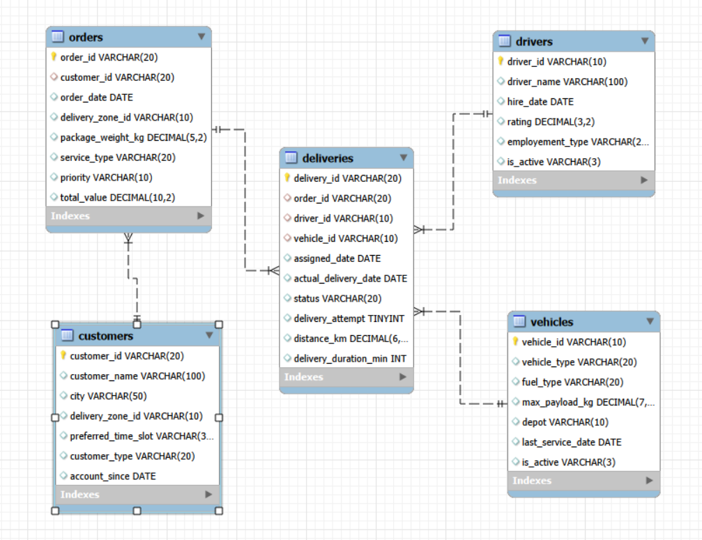
ER Diagram & Database Structure
Database Tables:
Customers | Orders | Deliveries | Drivers | Vehicles
Relationships:
Customers → Orders → Deliveries← Drivers & Vehicles
Primary Keys:
customer_id, order_id, delivery_id, driver_id, vehicle_id
Foreign Keys:
customer_id, order_id, driver_id, vehicle_id
Finding:
The connected tables enable complete analysis of customer orders and delivery operations.

Slide 9







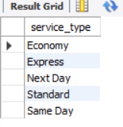


Basic Analysis : SQL Check

Slide 10
Key Analysis :
Verified the total number of customers, orders, and deliveries.
Identified available service types and vehicle types.
Checked active drivers and basic order metrics such as total order value and average package weight.
Key Findings :
The database contains data across customers, orders, deliveries, drivers, and vehicles.
The basic checks confirmed that the data is ready for further business and operational analysis.
Key Insight :
Basic SQL analysis provides an overall understanding of the dataset and establishes a foundation for detailed objective-based analysis.

Slide 11
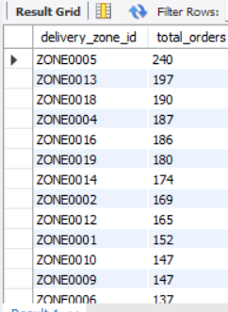
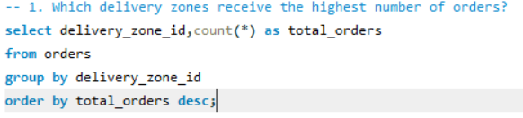
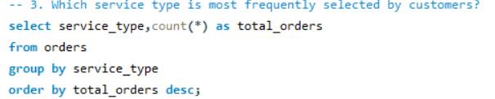
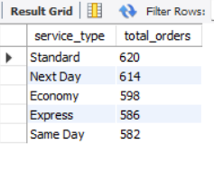
Analysis of Objectives : Delivery Demand
Key Analysis:
Analyzed orders by zone, service & priority with value and trend comparison.
Key Findings:
Demand varies by zone & service; Few zones contribute max value.
Key Insight:
Identify high-demand zones to optimize delivery resources.

Slide 12
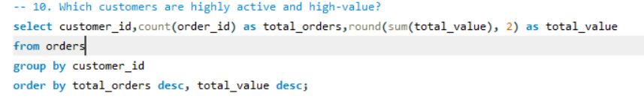
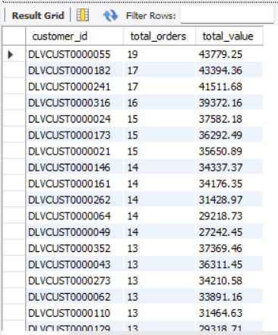
Analysis of Objectives : Customer Order Behaviour
Key Analysis:
Frequency & value analyzed by customer type, zone & time slot.
Key Findings:
Ordering differs by customers; Few customers drive max orders & value; Activity varies by zone.
Key Insight:
Identify frequent & high-value customers to improve retention.

Slide 13
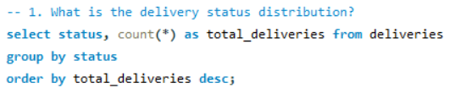
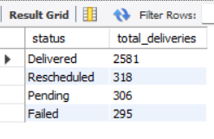
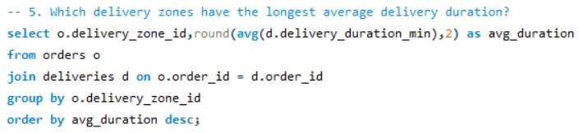
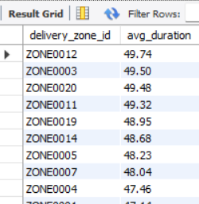
Analysis of Objectives : Delivery Performance
Key Analysis:
Outcomes analyzed by status, duration & delivery attempts across zones & service types.
Key Findings:
Outcomes & duration vary by zone; Failed deliveries need attention.
Key Insight:
Monitoring outcomes helps improve efficiency & customer service.

Slide 14
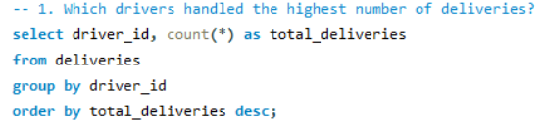
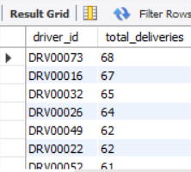
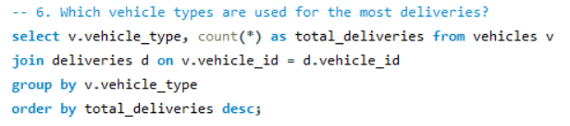
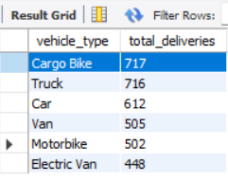
Analysis of Objectives : Driver & Vehicle Performance
Key Analysis:
Driver workload, vehicle usage & delivery duration compared.
Key Findings:
Workload uneven among drivers; Vehicle utilization varies; Performance differs
by workload.
Key Insight:
Combine workload & outcome data to optimize resource allocation.

Slide 15

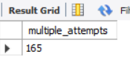
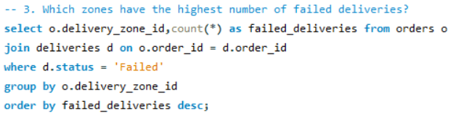
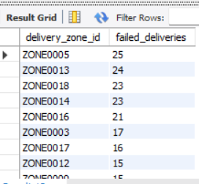
Analysis of Objectives : Delivery Problems
Key Analysis:
Failed, pending & rescheduled deliveries with multiple attempts analyzed by zone & service.
Key Findings:
Repeated attempts increase effort; Failures indicate service issues; Few zones need monitoring.
Key Insight:
Fixing recurring issues reduces effort & improves success rate.

Slide 16
Overall Key Findings
Delivery demand varies across zones, with differences in service types and priority levels.
Customer activity is uneven, with some customers contributing more orders and higher order value.
Delivery performance varies across operations, with differences in status, duration, and repeated attempts.
Driver and vehicle workloads are not uniform, highlighting opportunities for better resource allocation.
Failed, pending, rescheduled, and multiple-attempt deliveries indicate areas that need operational attention.

Slide 17
Overall Finding :
SQL analysis revealed important patterns in demand, customer behaviour, delivery performance, resource utilization, and operational problems, supporting data- driven improvements in last-mile delivery operations.
Overall Insight :
SQL analysis transformed operational data into actionable insights for improving delivery efficiency, resource utilization, and customer service.

Slide 18
Business Recommendations
Optimize resources by zone :
Allocate drivers and vehicles according to delivery demand across high-volume zones.
Improve delivery performance :
Focus on zones and service types with longer delivery durations or poorer outcomes.
Reduce repeated delivery attempts :
Investigate the causes of multiple attempts to reduce operational effort and delays.
Balance driver and vehicle workload :
Use workload and performance analysis to distribute deliveries more effectively.

Slide 19
Monitor delivery problems regularly :
Track failed, pending, and rescheduled deliveries to identify recurring operational issues.
Strengthen customer retention :
Identify frequent and high-value customers and use their ordering behaviour to improve service.
Overall Recommendation :
Use SQL- driven insights for continuous monitoring and data-based decision-making to improve delivery efficiency, resource utilization, and customer satisfaction.

Slide 20
Conclusion
The project successfully used MySQL and SQL analysis to understand last-mile delivery operations.
The analysis provided insights into delivery demand, customer behaviour, delivery performance, and resource utilization.
Identifying delivery problems and performance gaps helps the Operations team focus on areas requiring improvement.
Overall, the project demonstrates how data-driven insights can support better operational decisions and improve delivery efficiency.

Slide 21

THANK YOU

